Slide 1

Introduction

Slide 2

History
Works
Academic
Hobbies

Slide 3
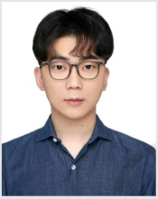



Pengcheng Ding Dante
1998 - ?
UE4√ Unity√ C++√
South China University of Technology
Game Development Engineer from Tencent and Netease
I was thinner at that time……

Slide 4
History
Works
Academic
Hobbies

Slide 5
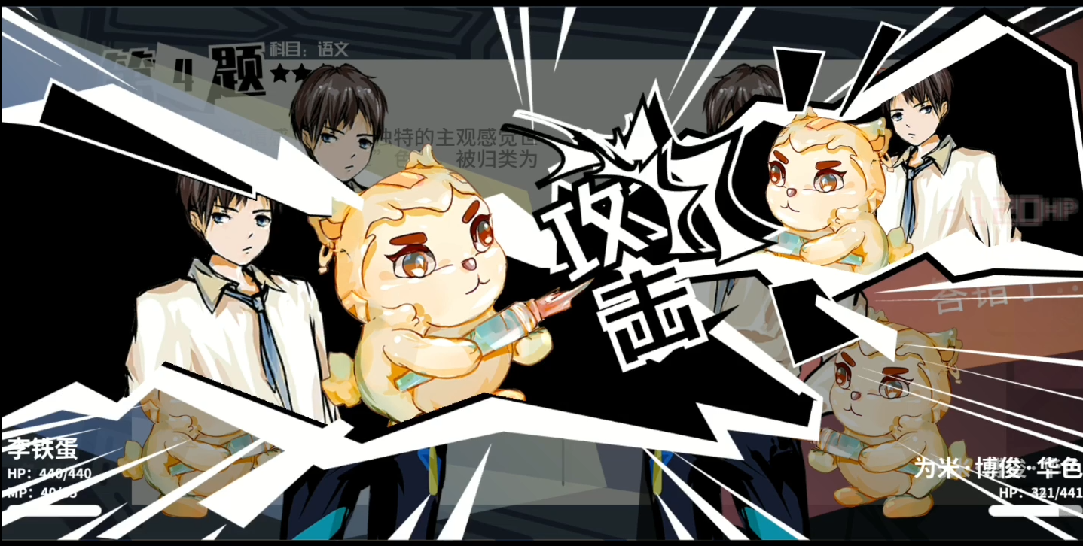


Made by Unity~

Slide 6
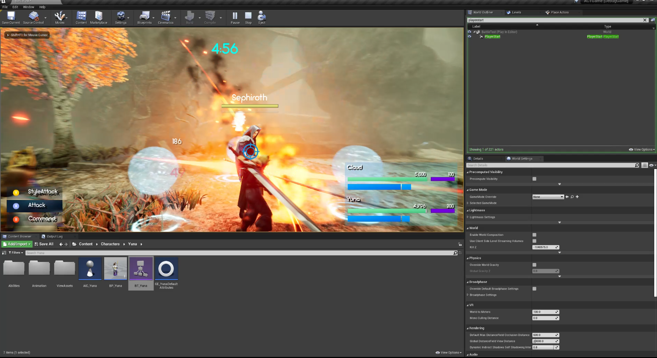
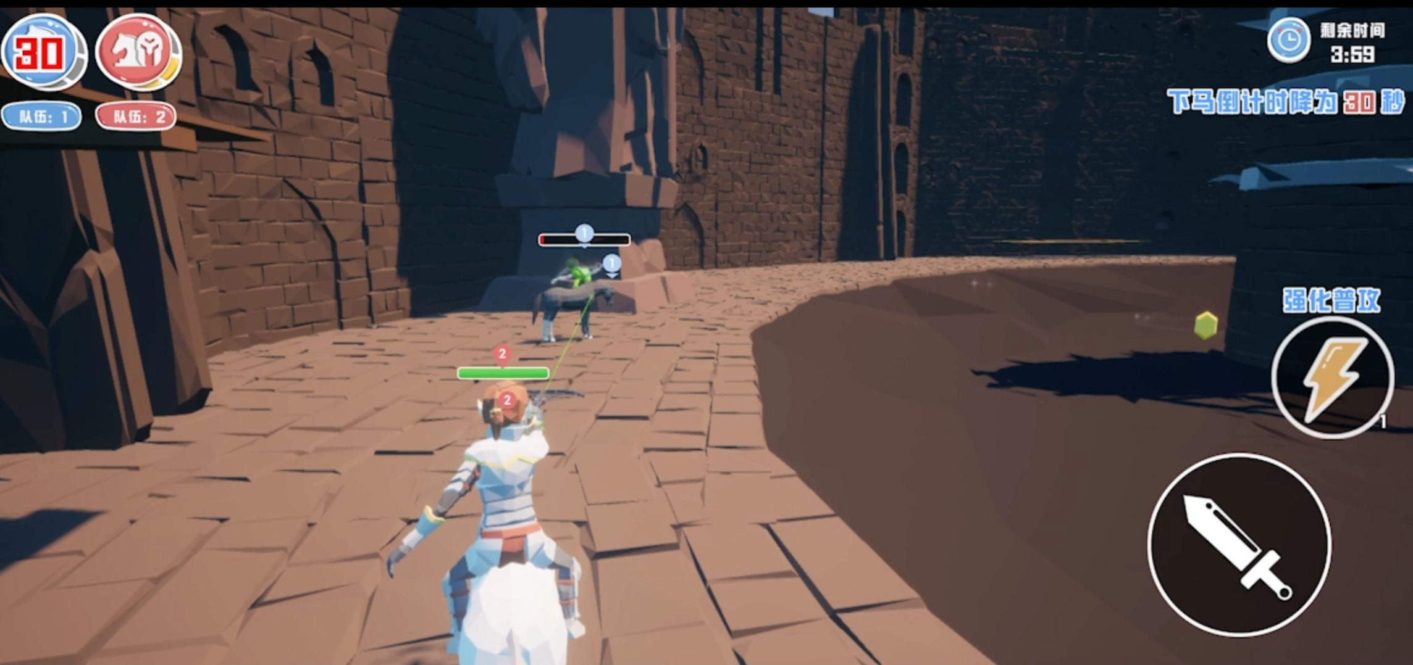
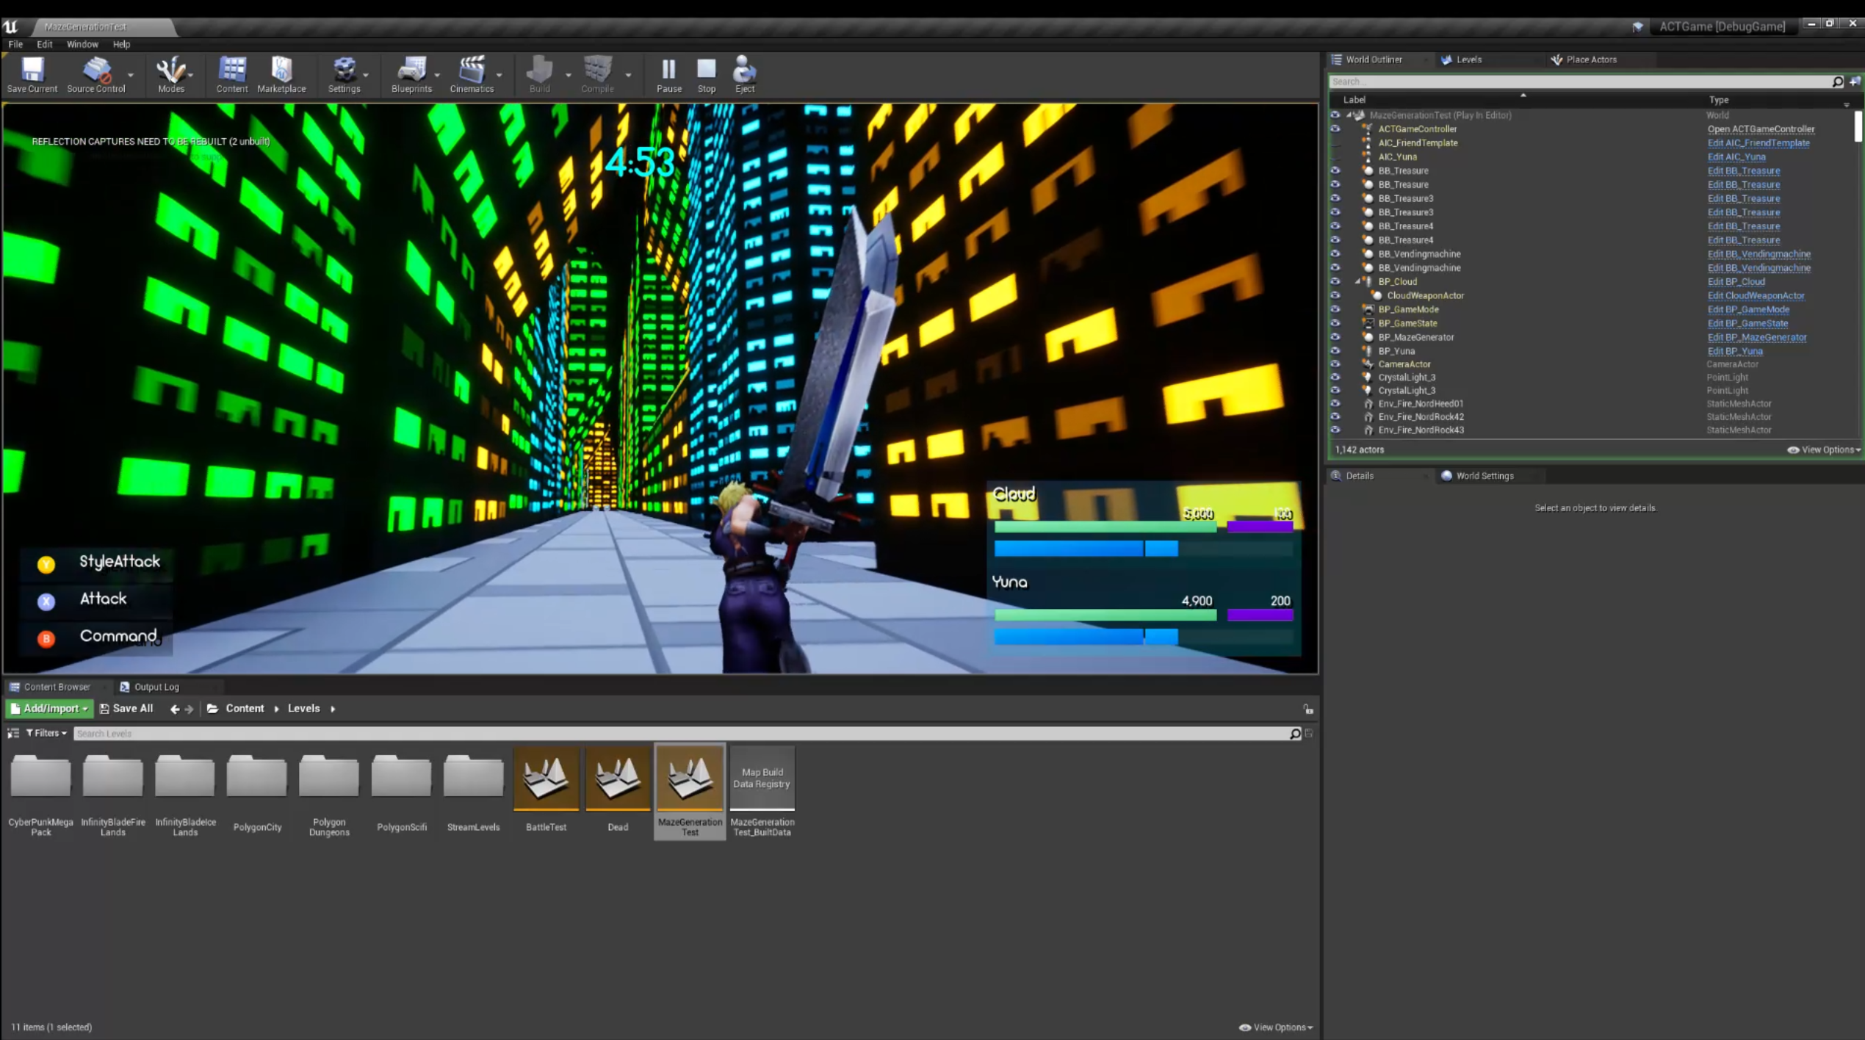
Made by UE4~

Slide 7
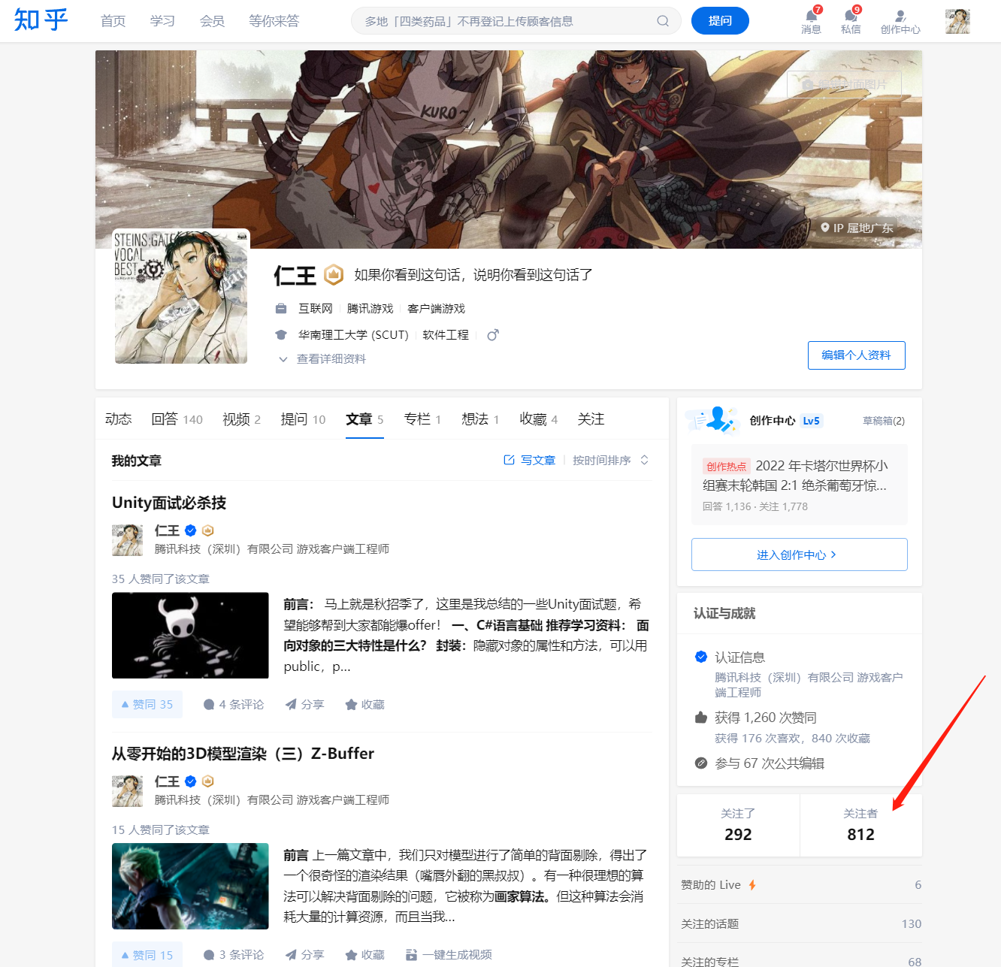
Write Articles~
Followers: 812

Slide 8
History
Works
Academic
Hobbies

Slide 9
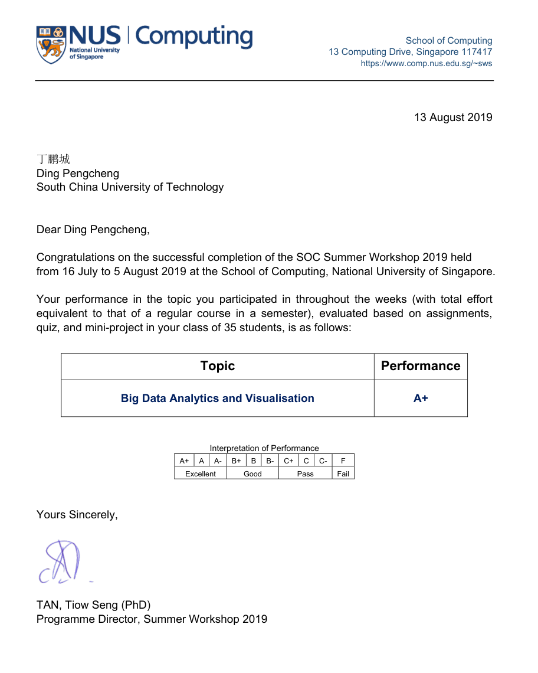
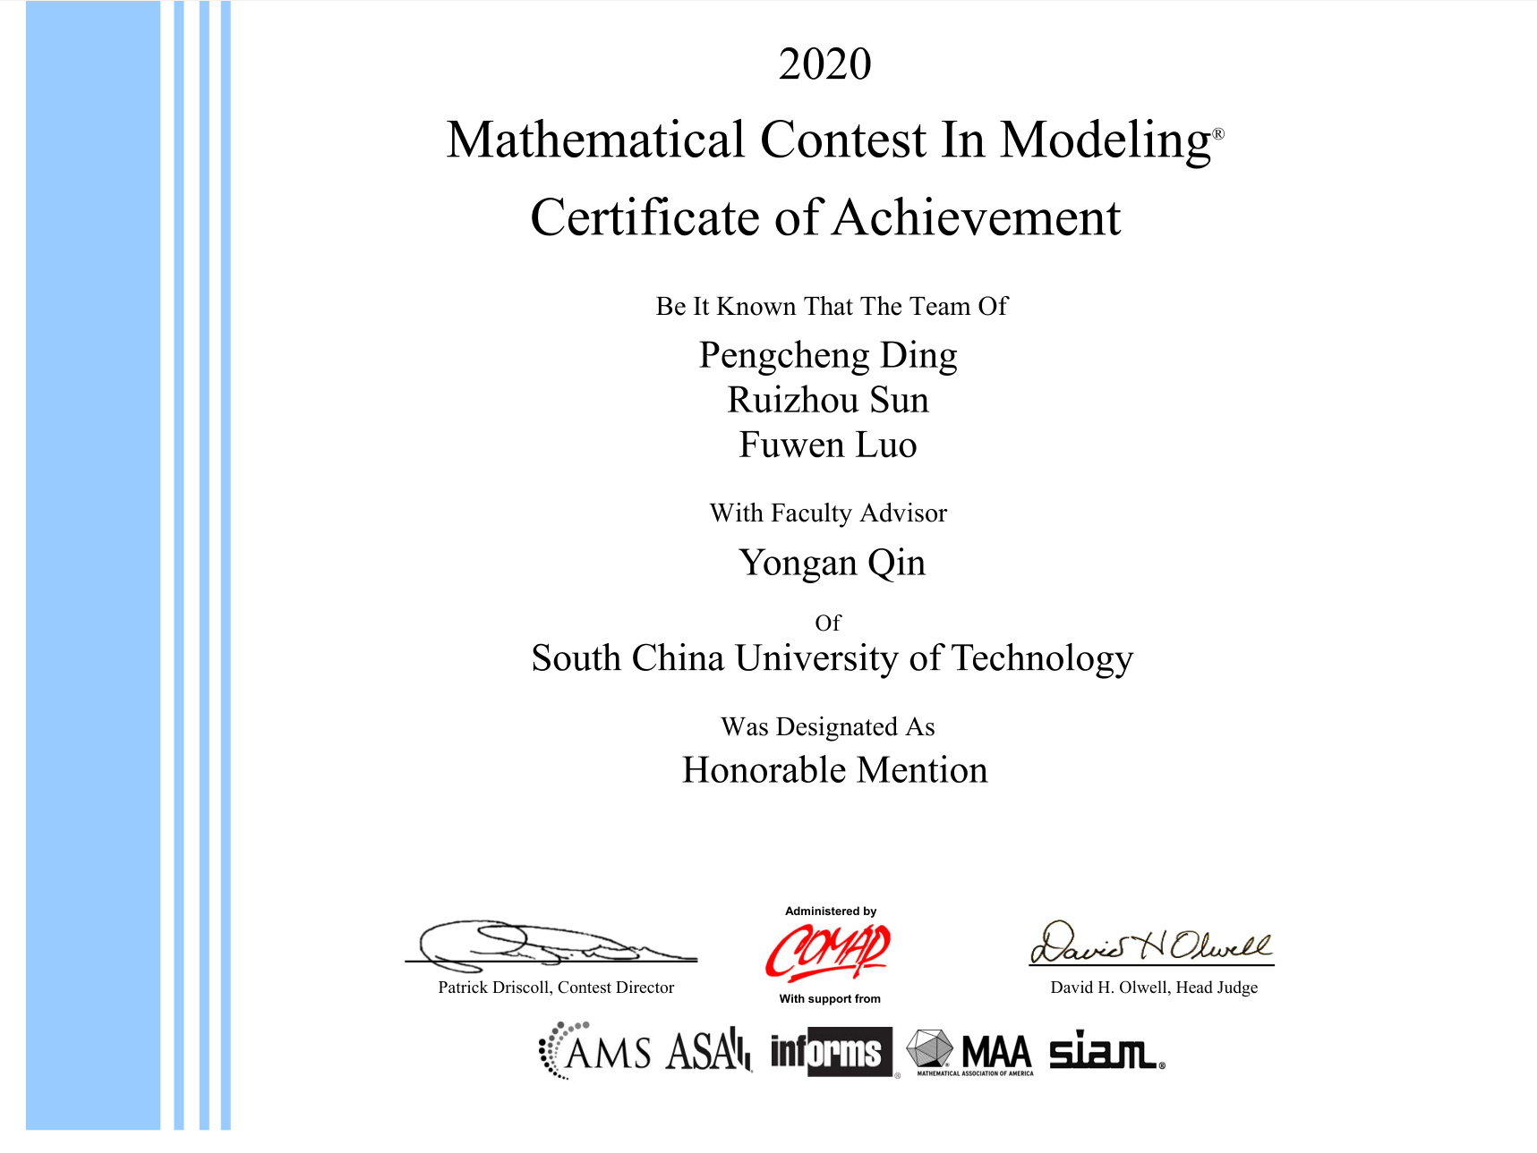
Honor~

Slide 10
History
Works
Academic
Hobbies

Slide 11
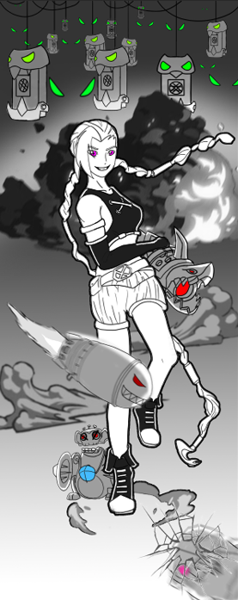
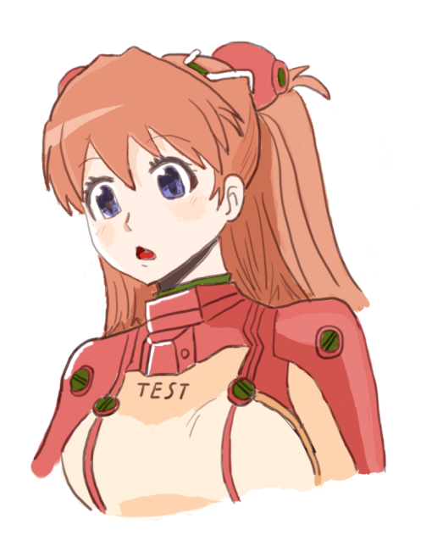
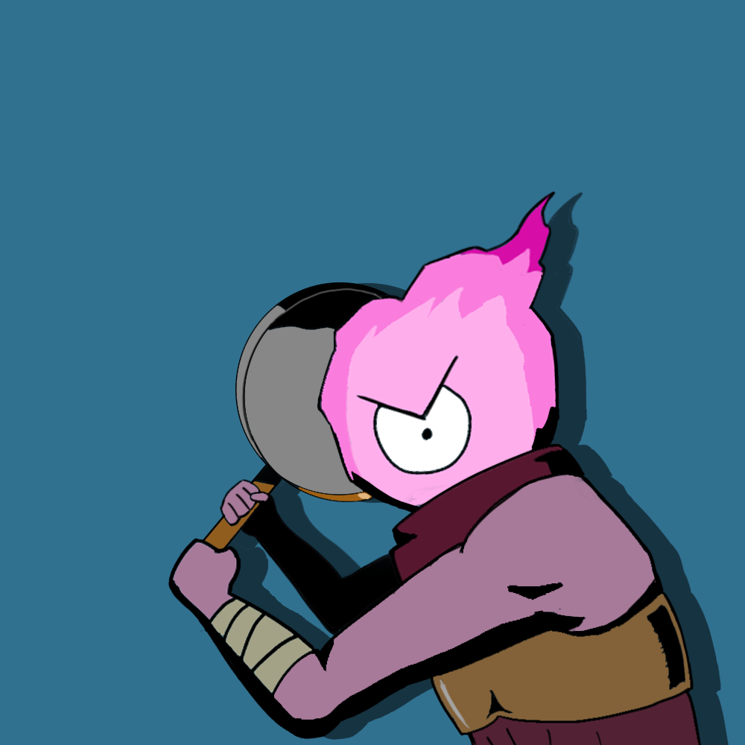

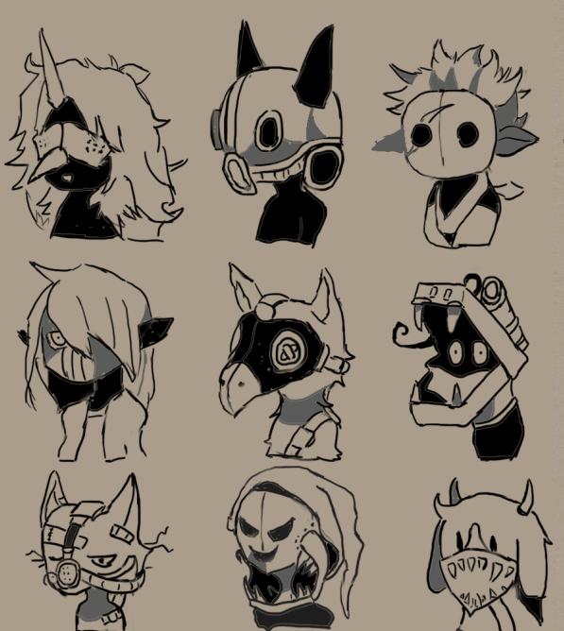

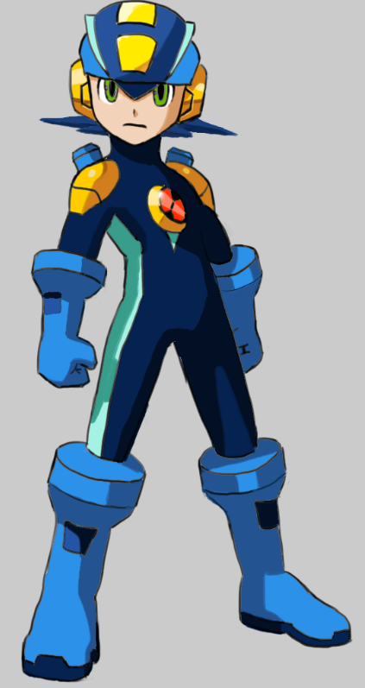
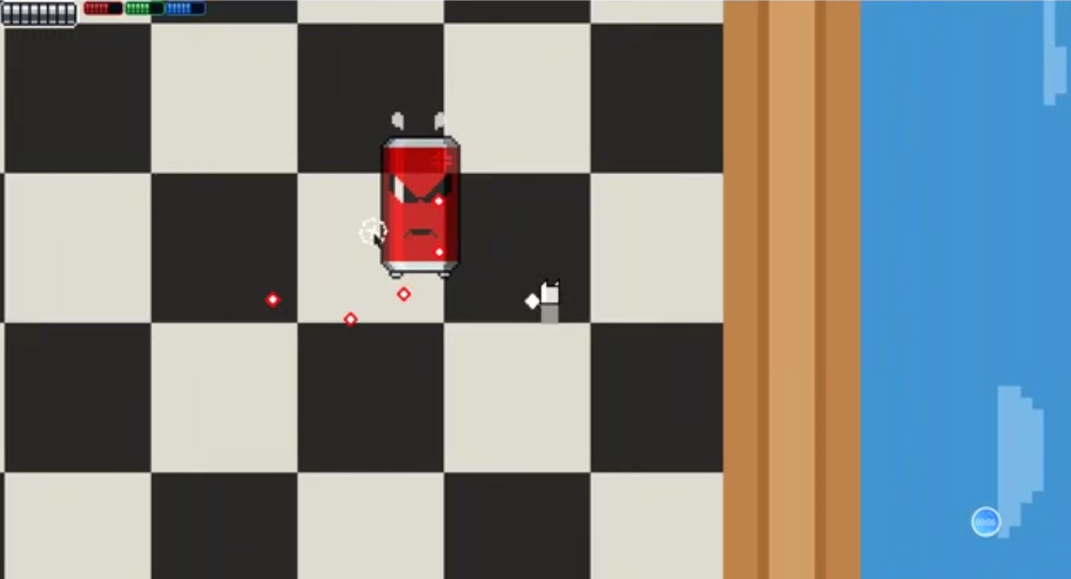

Slide 12

Wechat~

